Slide 1
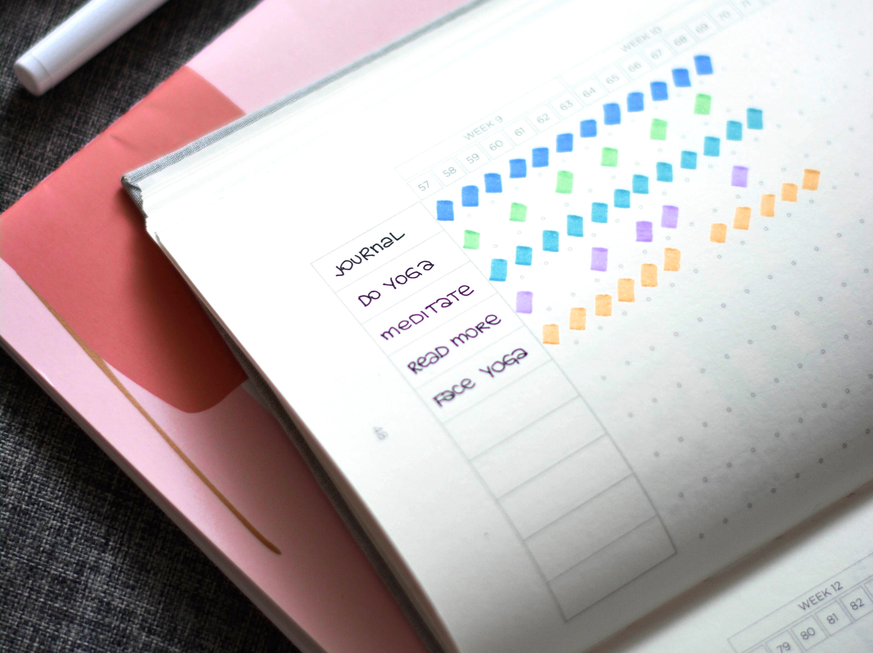
FLOURISH
To
Flourish (v.) : flour·ish
Flōrēre
grow or develop in a healthy way; develop successfully; thrive in growth; to be in a vigorous state; to prosper; to be in one’s prime.
What is flourish?
A whole school approach that focuses on understanding emotions and developing well-being.
A mental health education programme to introduce staff, students and parents to what good mental health is and how it can be developed.
Programme of Study Units:
Learn to flourish
A flourishing mind
Choose to flourish
Nourish to flourish
Time to flourish
Planning to flourish
Freedom to flourish
Why flourish
To develop the social emotional well-being and resilience of whole school community. This will be a strength and recognised as a driver to success. To reduce stigma around mental illness.
Empowering young people with the tools they need to flourish
KEY PRINCIPLES: What are the intentions?
Whole school Staff Training:
Increase knowledge and confidence to engage and deliver to students
Staff are role models
Whole school staff training
Student Flourish Programme
Community link
Student Flourish Programme:
Increase the understanding of the developing mind
To develop mentally healthy habits and routines
Develop core skills and techniques for a halthy mind now and in the future.
Reflection – Journals
Tools - MIndfulness
Techniques – habit trackers
Mind Management – Chimp paradox
Self-regulation - Emotions
FLOURISH PROGRAMME: How and where is flourish embedded?
Flourish Programme
Flourishing Fridays
Community
Whole School link
PSHE
Tutor Time
Home Activities & communication
Curriculum strand
Stigma
Kindness to yourself and others
Mental Strength
Increase in conversations about mental health
Feedback from year 7 parents evening
Positive Student
feedback
Impact
Implemented into lessons as a starter – English
Flourish is in its first stages of development and already we have seen a positive response.
2020 and beyond:
Flourish becomes part of regular staff training
Embedded in into PSHE
Established in form time
Regular feature of communication via Nidd News
#flourish
#TEAMNIDD
NIdderdale High School

